Slide 1
Lecture 3: Requirements Determination
Course ID: CSE471
Course Title: System Analysis and Design
Prepared by:
Dr. Muhammad Iqbal Hossain
Assistant professor Department of Computer Science & Engineering BRAC University.

Slide 2
Objectives
■ Understand how to create a requirements definition.
■ Become familiar with requirements analysis techniques.
■ Understand when to use each requirements analysis technique.
■ Understand how to gather requirements using interviews, JAD sessions, questionnaires, document analysis, and observation.
■ Understand when to use each requirements-gathering technique.

Slide 3
Segment 1: Requirements Specification
Segment 2: Requirement Gathering Techniques and Interview
Segment 3: JOINT APPLICATION DESIGN (JAD)
Segment 4: Other Requirement Gathering Techniques

Slide 4
Key Ideas
The goal of the analysis phase is to truly understand the requirements of the new system and develop a system that addresses them.
The first challenge is collecting and integrating the information
The second challenge is finding the right people to participate.

Slide 5
Analysis Phase
This phase takes the general ideas in the system request and
refines them into a detailed requirements definition (this chapter),
functional models
structural models and
behavioral models
This becomes the system proposal
Includes revised project management deliverables,
feasibility analysis and
workplan

Slide 6
Requirement Specification
A statement of what
the system must do or
characteristics it must have
Written from businessperson perspective – business requirement
Later requirements become more technical – system requirement

Slide 7
Functional vs. Nonfunctional
A functional requirement relates directly to a process the system has to perform or information it needs to contain.
Nonfunctional requirements refer to behavioral properties that the system must have, such as performance and usability.

Slide 8
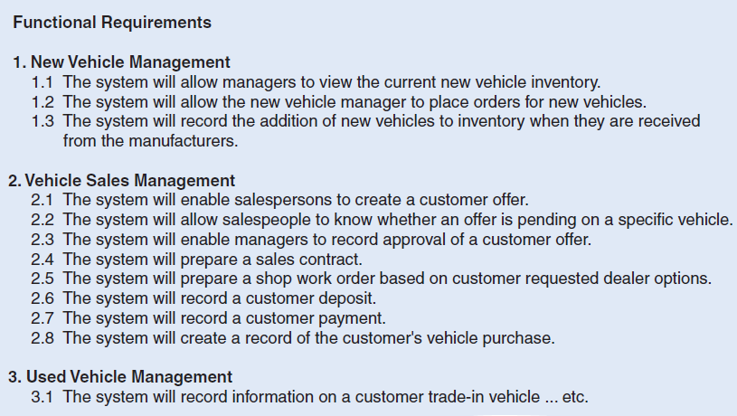
Functional Requirements example

Slide 9
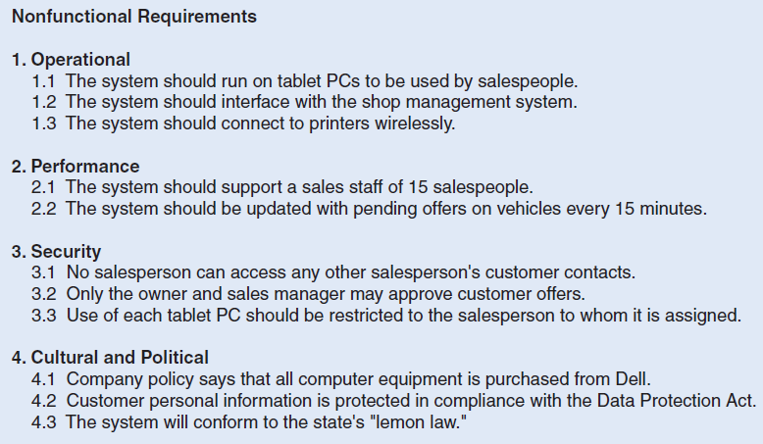
Nonfunctional Requirements example

Slide 10
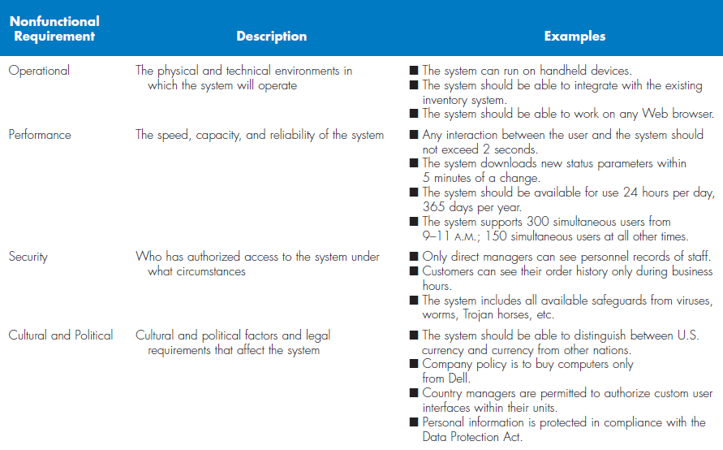
Types of Nonfunctional Requirements

Slide 11
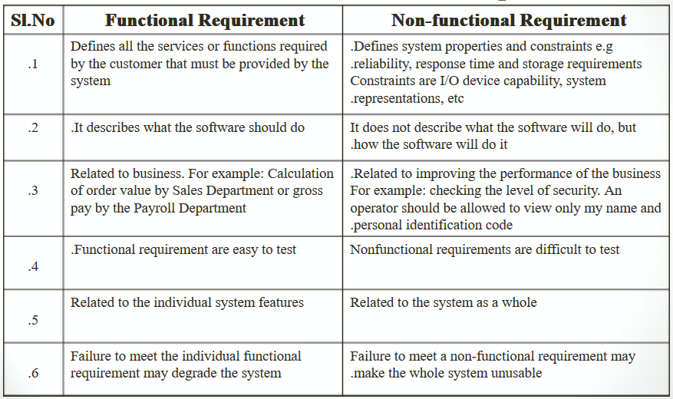
End of segment 1

Slide 12
Segment 2
Requirement Gathering Techniques and Interview

Slide 13
Requirement Gathering Techniques
An analyst search for requirements using a variety of techniques
Make sure that the current business processes and the needs for the new system are well understood before moving into design.
Five most commonly used requirements elicitation techniques:
Interviews
JAD sessions
Questionnaires
Document analysis
Observation.

Slide 14
Interviews -- Five Basic Steps
Selecting interviewees
Designing interview questions
Preparing for the interview
Conducting the interview
Post-interview follow-up

Slide 15
Selecting Interviewees
Based on information needed
Often good to get different perspectives
Managers
Users
Ideally, all key stakeholders

Slide 16
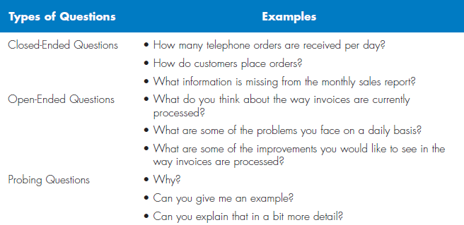
Types of Questions

Slide 17
Designing Interview Questions
Unstructured interview
Broad, roughly defined information
Structured interview
More specific information

Slide 18
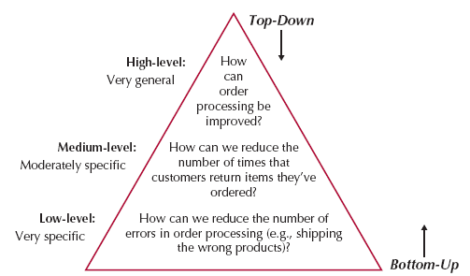
Questioning Strategies

Slide 19
Interview Preparation Steps
Prepare general interview plan
List of question
Anticipated answers and follow-ups
Confirm areas of knowledge
Set priorities in case of time shortage
Prepare the interviewee
Schedule
Inform of reason for interview
Inform of areas of discussion

Slide 20
Conducting the Interview
Appear professional and unbiased
Record all information
Check on organizational policy regarding tape recording
Be sure you understand all issues and terms
Separate facts from opinions
Give interviewee time to ask questions
Be sure to thank the interviewee
End on time

Slide 21
Conducting the Interview Practical Tips
Don’t worry, be happy
Pay attention
Summarize key points
Be brief
Be honest
Watch body language

Slide 22
Post-Interview Follow-Up
Prepare interview notes
Prepare interview report
Look for gaps and new questions

Slide 23
Interview Report
INTERVIEW REPORT
Interview notes approved by: ____________
Person interviewed ______________
Interviewer _______________
Date _______________
Primary Purpose:
Summary of Interview:
Open Items:
Detailed Notes:

Slide 24
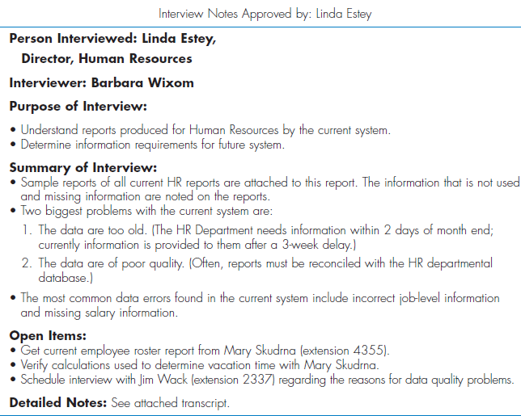
Sample Interview Report
End of segment 2

Slide 25
Segment 3 JOINT APPLICATION DESIGN (JAD)

Slide 26
JAD Key Ideas
Allows project managers, users, and developers to work together
May reduce scope creep by 50%. (changes, continuous or uncontrolled growth in a project’s scope)
Avoids requirements being too specific or too imprecise

Slide 27
Joint Application Design (JAD) Important Roles
Facilitator
sets the meeting agenda and guides the discussion
Scribe
assist the facilitator by recording notes, making copies, etc.
Project team, users, and management

Slide 28
Joint Application Design (JAD) Setting
U-Shaped seating
Away from distractions
Whiteboard/flip chart
Prototyping tools
e-JAD

Slide 29
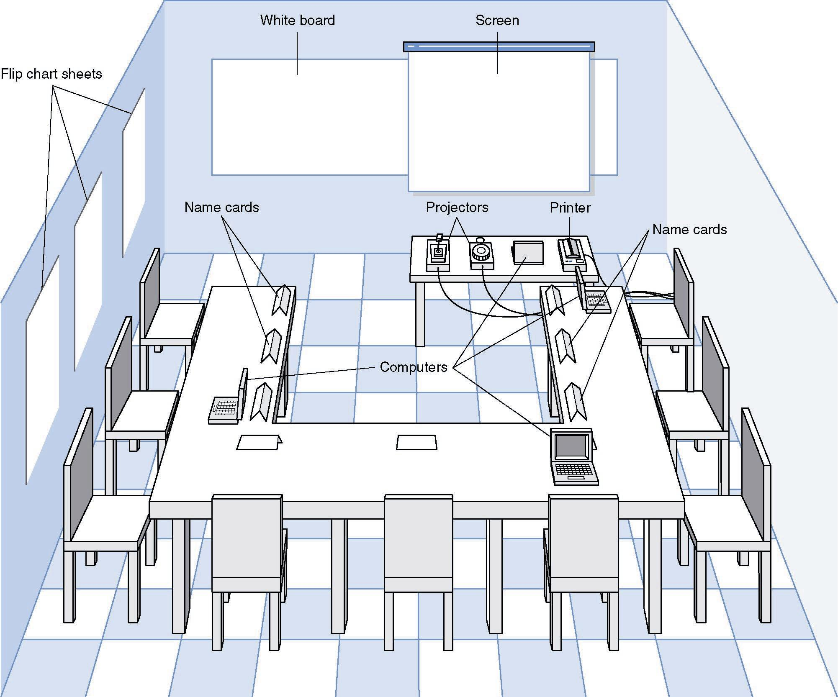
JAD Meeting Room
JPEG Figure 5-5 Goes Here

Slide 30
The JAD Session
Tend to last 5 to 10 days over a three week period
Prepare questions as with interviews
Formal agenda and groundrules
Facilitator activities
Keep session on track
Help with technical terms and jargon
Record group input
Help resolve issues
Post-session follow-up

Slide 31
Managing Problems in JAD Sessions
Reducing domination
Encouraging non-contributors
Side discussions
Agenda merry-go-round
Violent agreement
Unresolved conflict
True conflict
Use humor
End of segment 3

Slide 32
Segment 4
Other Requirement Gathering Techniques

Slide 33
Questionnaires

Slide 34
Questionnaire Steps
Selecting participants
Using samples of the population
Designing the questionnaire
Careful question selection
Administering the questionnaire
Working to get good response rate
Questionnaire follow-up
Send results to participants

Slide 35
Good Questionaire Design
• Begin with nonthreatening and interesting questions.
• Group items into logically coherent sections.
• Do not put important items at the very end of the questionnaire.
• Do not crowd a page with too many items.
• Avoid abbreviations.
• Avoid biased or suggestive items or terms.
• Number questions to avoid confusion.
• Pretest the questionnaire to identify confusing questions.
• Provide anonymity to respondents.

Slide 36
Document Analysis
Document analysis is used to understand the as-is system.
Very common in healthcare as majority of the systems are developed to replace paper based workflow.
Forms, reports, policy manuals, organization charts describe the formal system that the organization uses.
Analysis of previous system development documentation: currency should be considered.

Slide 37
Observation
The act of watching processes being performed.
It is a powerful tool to gain insight into the as-is system, and to check the validity of information gathered from other sources.
Nonetheless, people tend to be extremely careful in their behaviors when they are being watched.

Slide 38
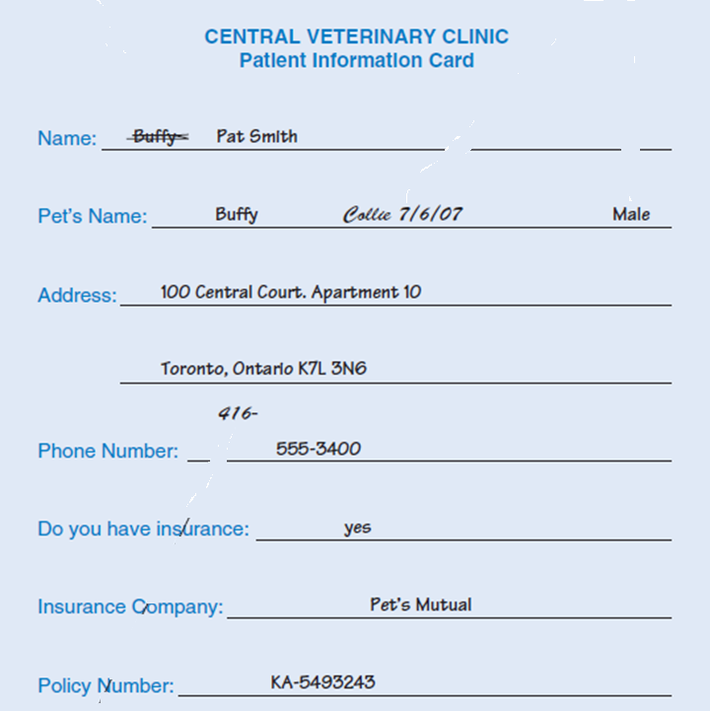

Slide 39
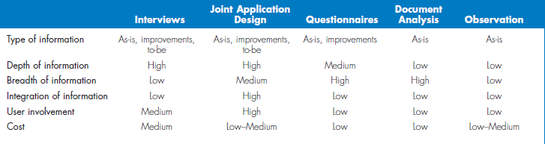
Selecting the Appropriate Techniques

Slide 40
Summary
First Step is to determine requirements
Systems analysts use these techniques
Interviews
JAD
Questionnaires

